Slide 1
Y u m C y c l e : Revolutionizing Food Management

Slide 2
Introduction To YumCycle
Our project, YumCycle, is a fridge contents management application. This mobile app is designed around helping people of all ages and places in managing their fridge leftovers. The idea has started in our own dorm room, where every week, we buy a lot of unnecessary groceries and always end up throwing some of them away. This is how this project was born, we realized we could optimize the way we handle our aliments and also find new recipes to cook and eat healthier. The main focus of this app is to help the user keep track of what is in their fridge and generate recipes based on this information, so that we will minimize waste.

Slide 3
What do we want to achieve?
01
02
03
Efficient Inventory Management
Reducing Food Waste
Recipe Discovery and Sharing
YumCycle enables users to efficiently manage their fridge and pantry contents by providing tools to track what they have on hand.
The application is designed with a focus on reducing food waste, allowing users to receive suggestions recipes that utilize ingredients that might otherwise go to waste.
YumCycle enhances the user experience by offering personalized recipe suggestions based on the ingredients users already have, and share their own recipes.

Slide 4
KEY FEATURES
◉ Barcode Scanning
One of the standout features of YumCycle is its barcode scanning capability. Users can quickly add items to their virtual fridge simply by scanning product barcodes, making inventory updates fast and efficient, while eliminating manual entry errors.
◉ Manual Entry Options
For products without barcodes, YumCycle provides a manual entry option. This ensures that users can still log all their pantry and fridge items, regardless of packaging, thus maintaining a comprehensive inventory for better meal planning.
◉ Recipe Suggestions
Based on the current inventory, YumCycle offers personalized recipe suggestions that help users utilize their existing ingredients. This feature not only encourages creative cooking but also helps in meal preparation while minimizing food waste.

Slide 5
— POPE FRANCIS
“Throwing away food is like stealing from the table of those who are poor and hungry.”

Slide 6
Backend Development with Java and Spring Boot
◉ Java as a Programming Language
Java is a robust and scalable programming language that is widely used for building mobile and backend applications.
Its security features and cross-platform capabilities make it an excellent choice for developers. Java's compatibility with Android also allows for seamless mobile application development, making it a versatile tool in the tech stack of YumCycle.
◉ Spring Boot Framework
Spring Boot is a revolutionary framework that simplifies the development of Java applications.
By offering pre-configured settings, Spring Boot allows developers to focus on building features rather than dealing with complex configurations. It supports the creation of RESTful APIs, enhances security protocols, and efficiently manages database interactions, playing a crucial role in the architecture of YumCycle.
◉ MySQL Database Management
MySQL serves as the relational database management system for YumCycle, where it efficiently stores critical data such as user accounts, inventory items, recipes, and user reviews.
Its robust querying capabilities and reliability ensure that the application can handle large volumes of data while maintaining performance and integrity.

Slide 7
SECURITY FEATURES
YumCycle implements various security measures to protect user data and application integrity. Utilizing Spring Boot's built-in security features, the application safeguards sensitive information, implements authentication processes, and enforces authorization protocols, ensuring a secure environment for users.

Slide 8
API INTEGRATION
Barcode API Integration
YumCycle leverages a Barcode API to simplify the addition of items to the virtual fridge. Users can scan product barcodes, and the API retrieves product details such as name, brand, and packaging. This reduces manual entry, speeds up inventory management, and improves accuracy in item tracking. You’ll never forget to buy milk.
Recipe API Integration
YumCycle integrates a Recipe API to dynamically fetch recipes based on users’ inventory and preferences. The API matches available ingredients with a diverse recipe database, offering tailored suggestions that reduce food waste This integration enriches the recipe discovery experience while maintaining efficiency and reliability.

Slide 9

USER EXPERIENCE AND INTERACTION
Because user experience is so important to us, we will ask you to be the first ones to make a decision related to the user interface:
Please scan this QR code and help us!

Slide 10
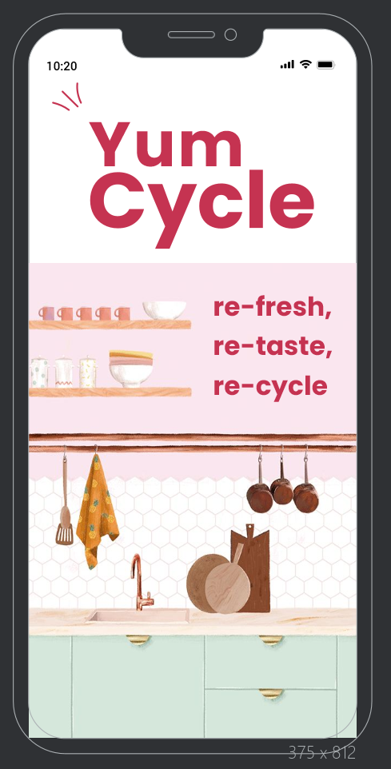
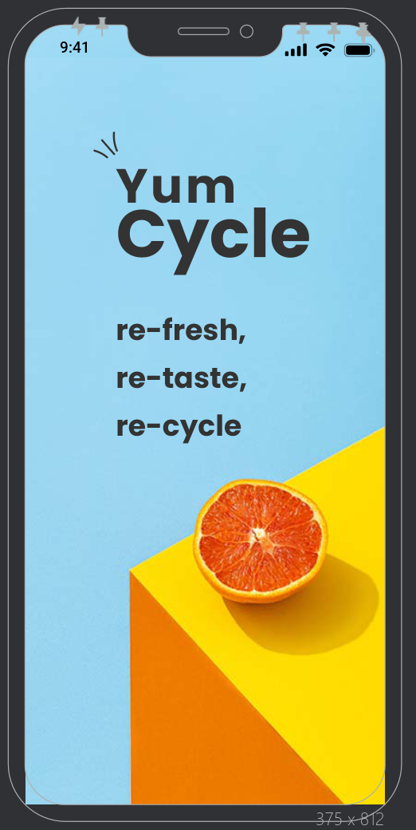
OPTION A
OPTION B

Slide 11

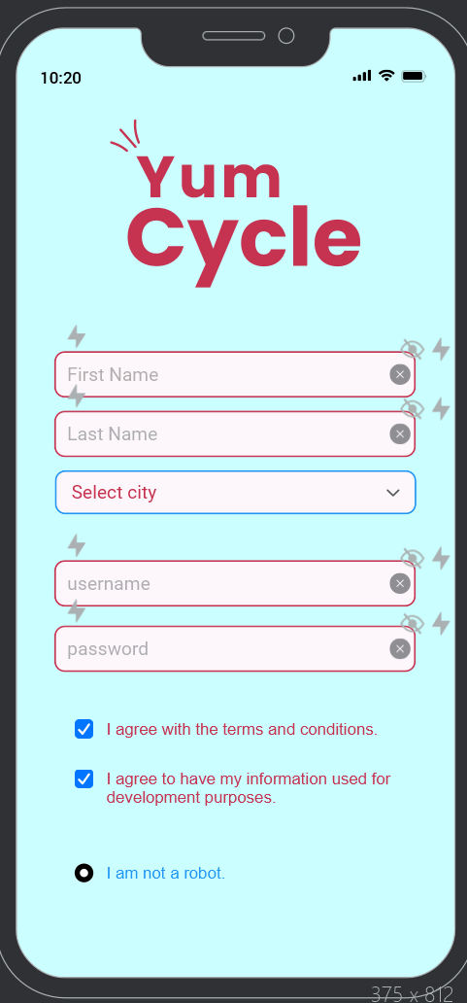
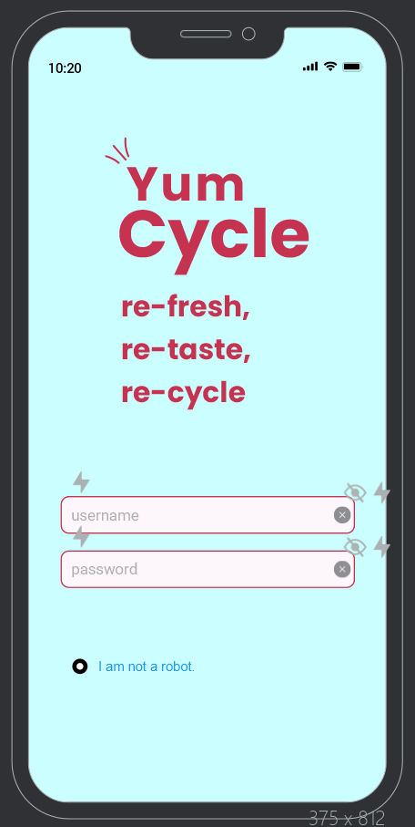
User Registration and Authentication
- Secure User Registration: Enables users to create accounts with strong passwords, ensuring the protection of personal information.
- Efficient Authentication Process:
Provides quick and seamless login options, including password recovery and 'Remember Me' functionality.
- User Profile Management:
Allows users to update personal details, change passwords, and customize notification preferences for a tailored experience.

Slide 12
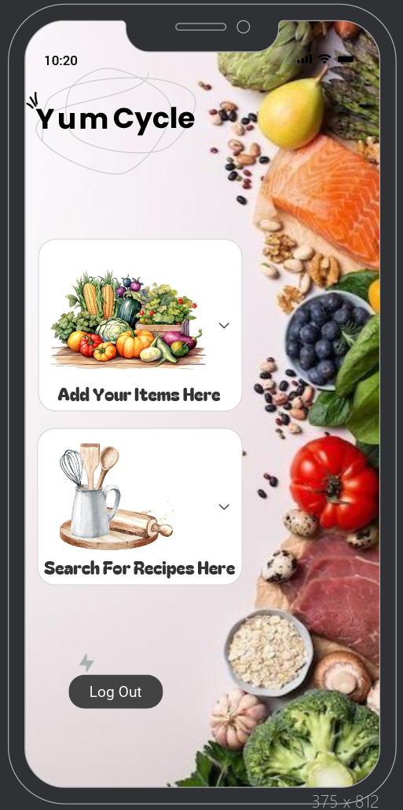
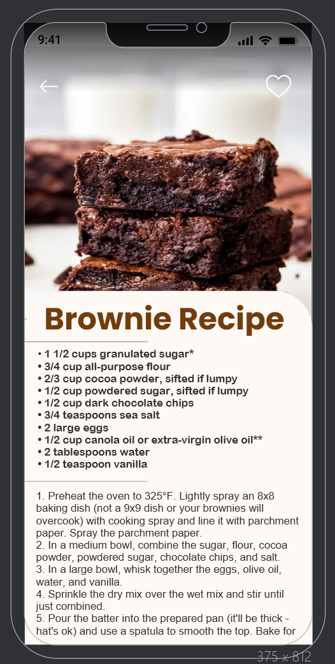
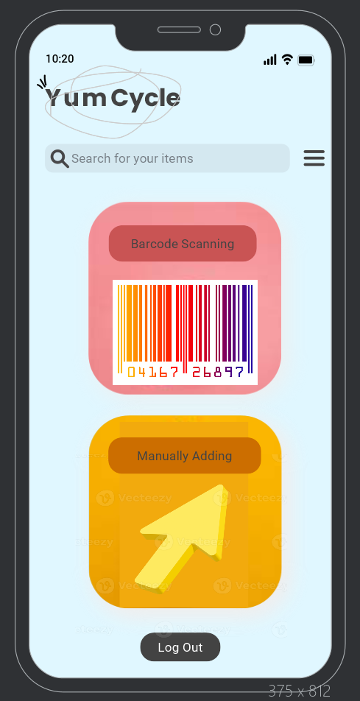
Inventory Management And Recipe Discovery
◉ Personalized Recipes:
YumCycle enhances the cooking experience by offering personalized recipe suggestions based on the ingredients available in the user's inventory and application allows users to submit their own recipes, fostering a community of sharing and creativity.
◉ Barcode Scanning Feature
Users can quickly add items to their fridge and pantry by scanning barcodes.
◉ Manual Entry Options
For items without barcodes, YumCycle provides a manual entry option. Users can easily input product names and quantities.

Slide 13
COMPETING SOFTWARE
Streamlined User Interface
YumCycle offers a user-friendly interface that prioritizes essential functionalities, making it easy for users to navigate. Unlike competitors, the design focuses on simplicity, allowing users to quickly access inventory management and recipe discovery.
Community Engagement
YumCycle fosters a community-driven approach, enabling users to share their personal recipes. This feature not only enhances user engagement but also enriches the recipe database, providing a diverse range of options for all users.
No Subscription Required
One of the standout features of YumCycle is that it does not require users to subscribe. This model sets it apart from competitors like Kitchen Pal, which may include subscription fees, thus making YumCycle a more accessible option for budget-conscious users.
Focus on Essential Functions
While Kitchen Pal provides a plethora of features, YumCycle emphasizes a streamlined approach by honing on essential functions that help minimize food waste and grocery expenses, making it a practical choice for many households.

Slide 14
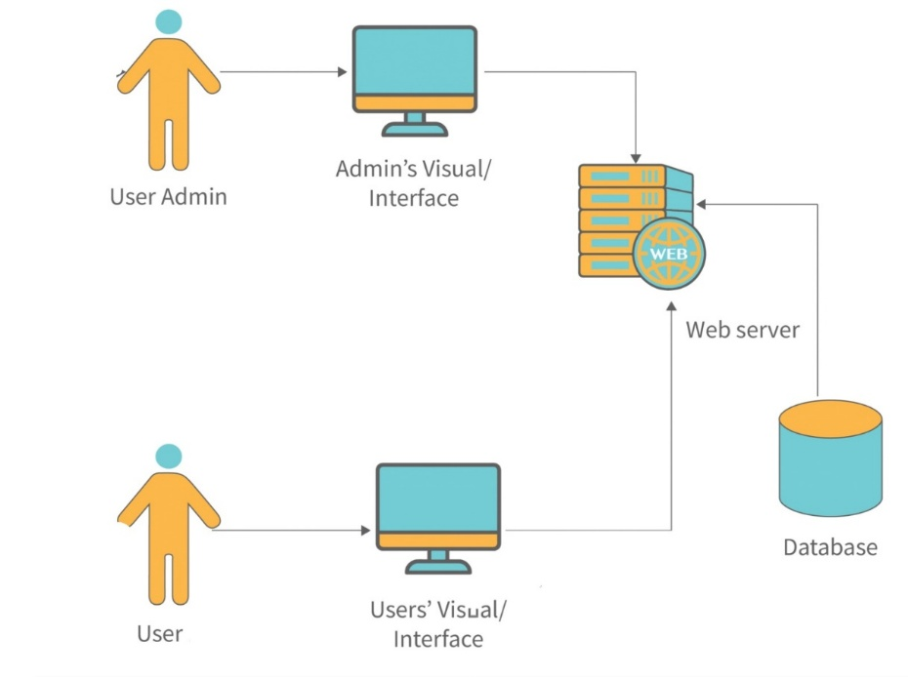
DIAGRAMS
1. General Architecture Diagram

Slide 15
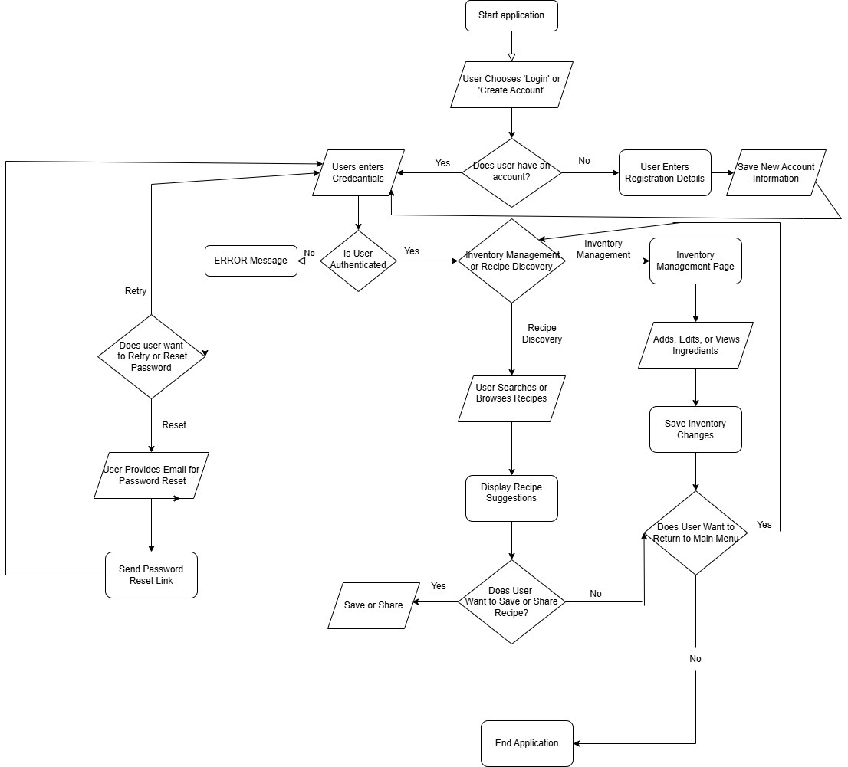
DIAGRAMS
2. Flowchart Diagram

Slide 16
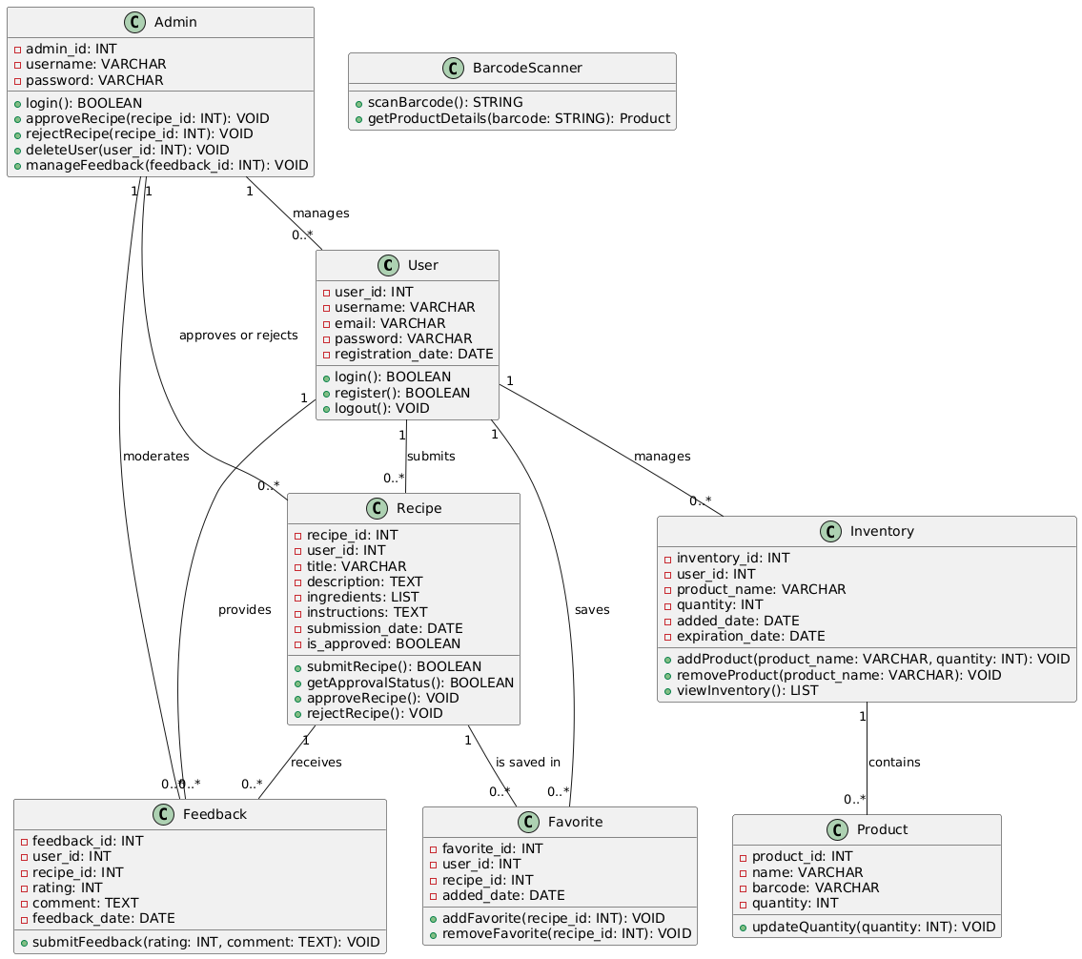
DIAGRAMS
3. Class Diagram

Slide 17
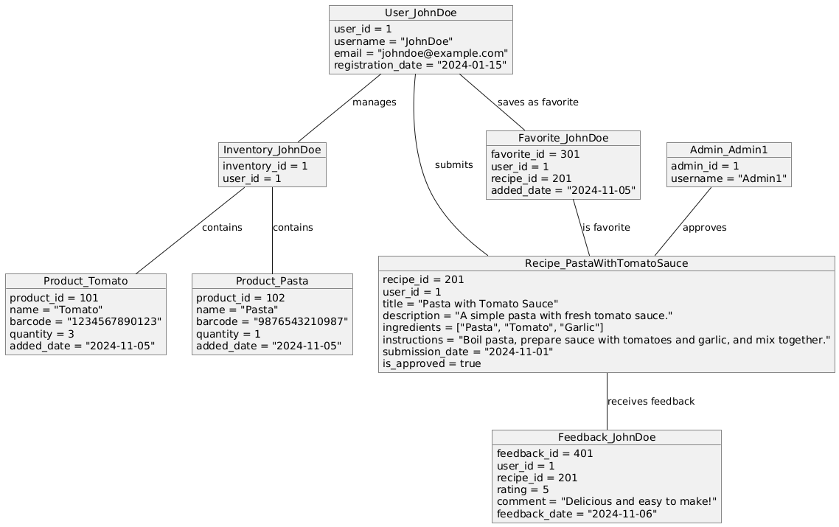
DIAGRAMS
4. Object Diagram

Slide 18
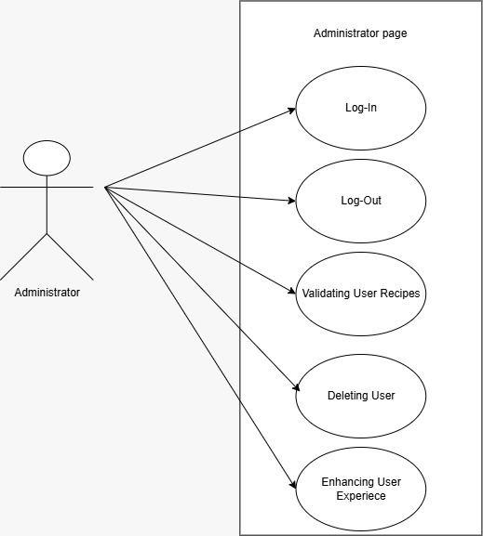
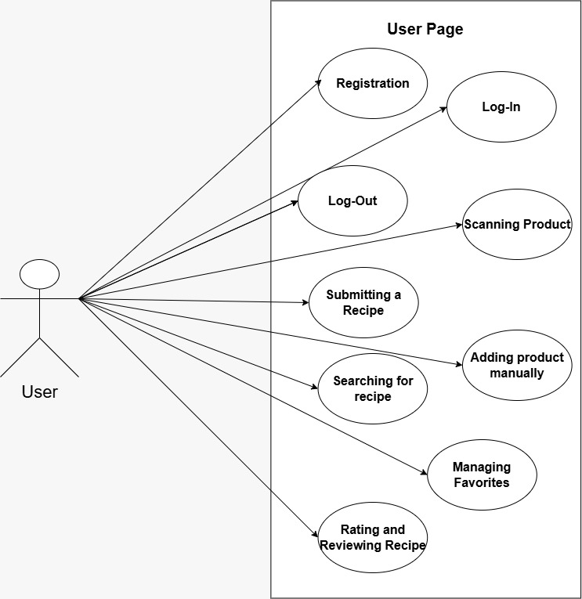
DIAGRAMS
5. Use Case Diagrams

Slide 19
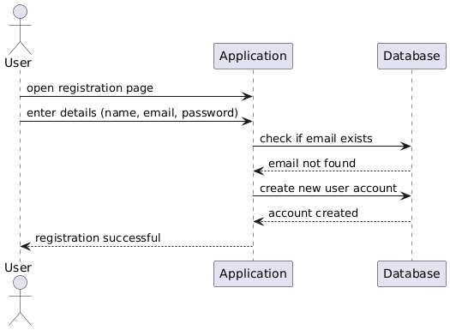
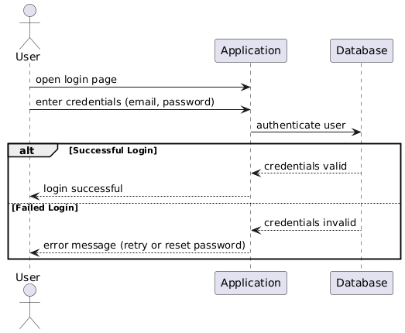
DIAGRAMS
6. Sequence Diagrams

Slide 20
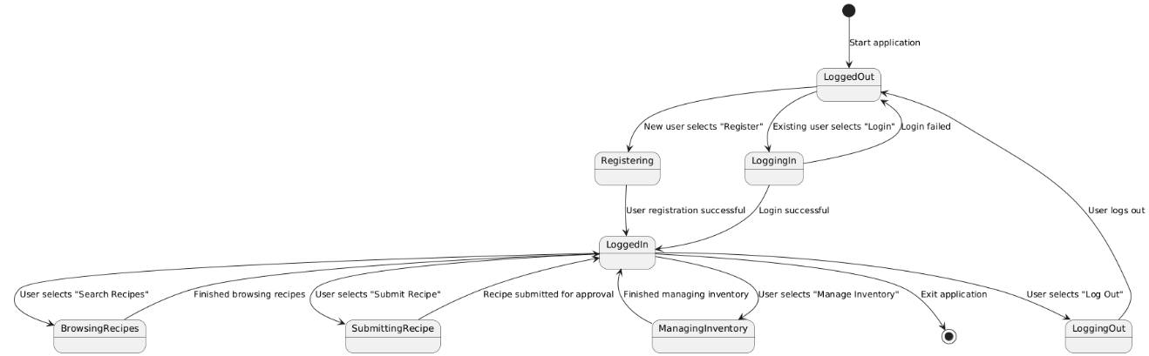
DIAGRAMS
8. State Transition Diagram

Slide 21
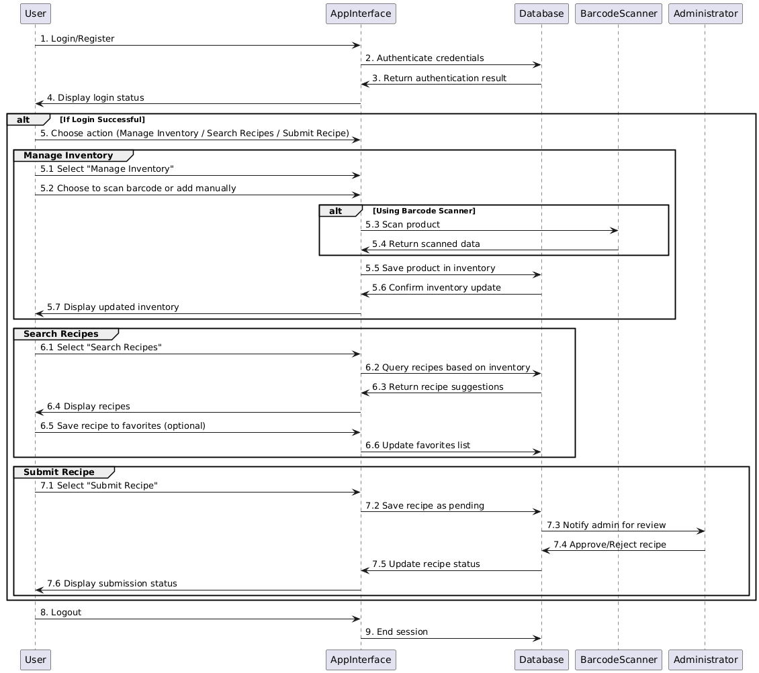
DIAGRAMS
9. Communication Diagram

Slide 22
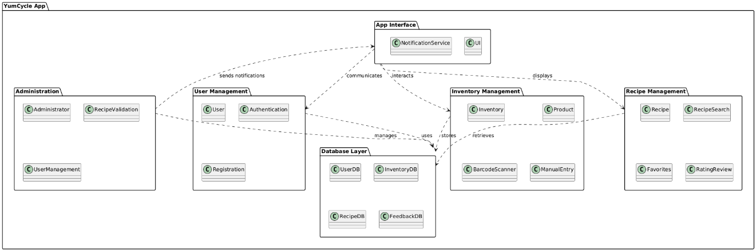
DIAGRAMS
10. Package Diagram

Slide 23
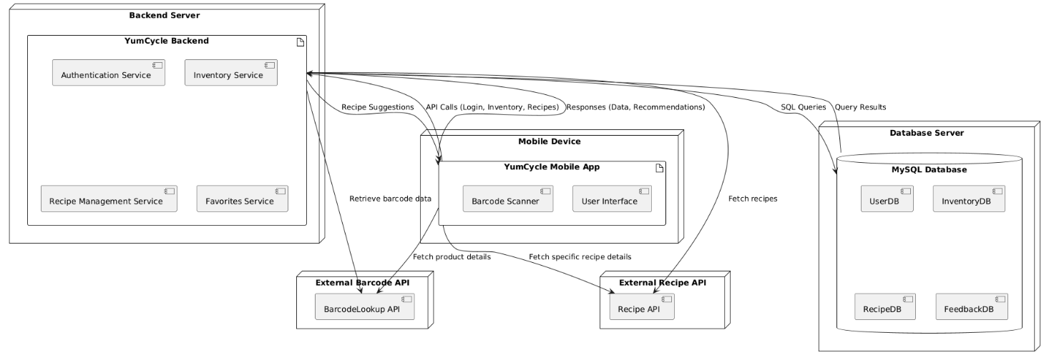
DIAGRAMS
11. Deployment Diagram

Slide 24
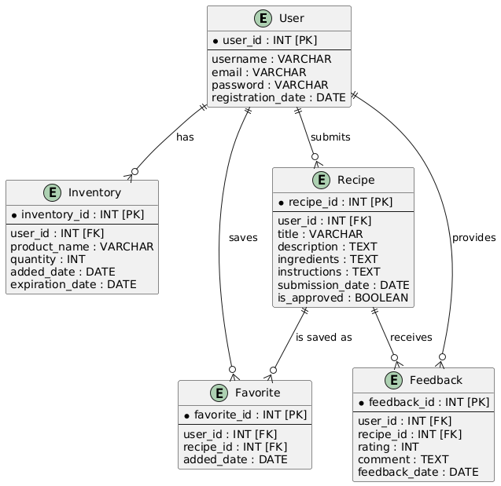
DIAGRAMS
12. Database Diagram

